Slide 1
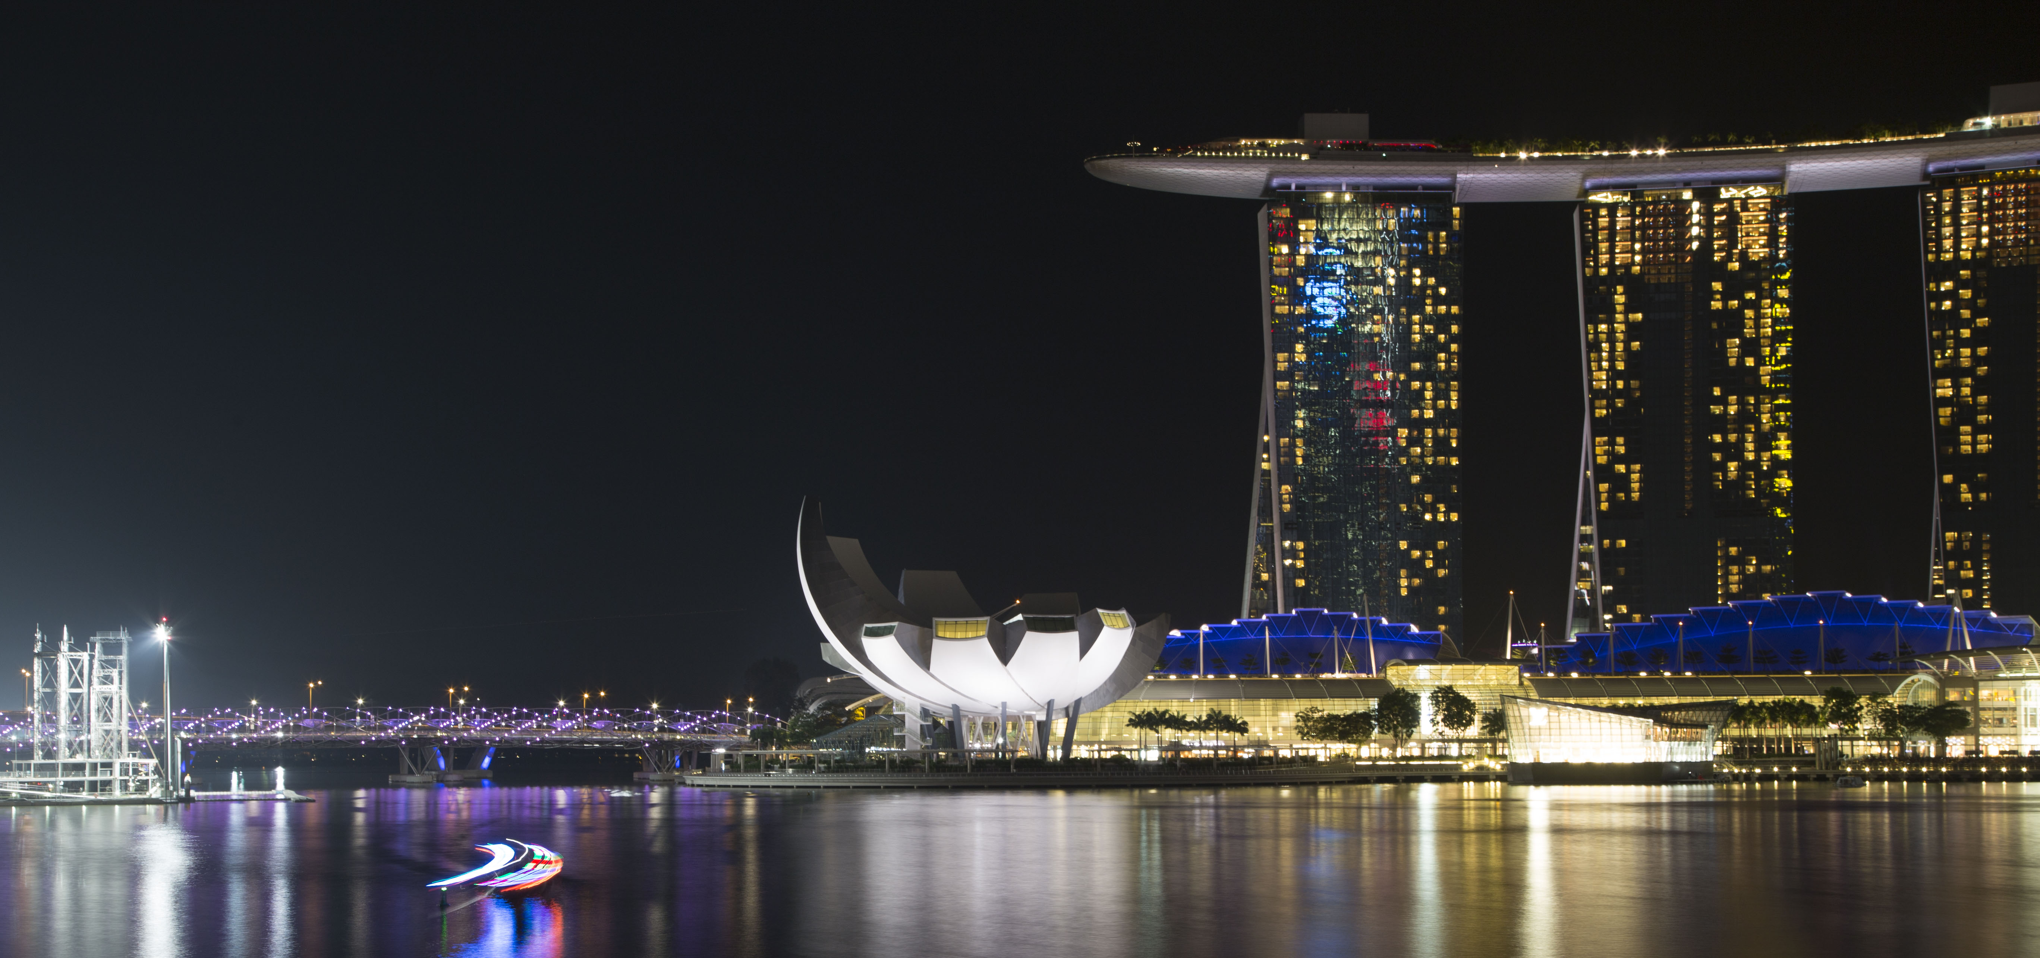











PowerShell Conference Asia
The DSC Pull Server

Slide 2



Powershell quick starts, tutorials, API reference, and code examples!
Advance your career with hands-on training at docs.microsoft
Check it out here:

Slide 3

We really do!
Show some love and join the conversation by tweeting
@MicrosoftTech

Slide 4

Whoami
Name : Ben Gelens
Job : Consultant
MVP : CDM (PowerShell)
Company : InSpark
Email : ben@bgelens.nl
Twitter : @bgelens
GitHub : bgelens
Blog : bgelens.nl
PowerShell Conference
Singapore 2018

Slide 5
Agenda
What is new in DSC Pull Server (Server 1803 (a.k.a. RS4)/2019)?
Architecture
EDB to SQL migration, howto?
Demo time!
PowerShell Conference
Singapore 2018

Slide 6

What is new in DSC Pull Server in RS4/2019?
Scalable
Highly available
No more dealing with ESENT!
Extensible
Easy change of server side ConfigurationName assignment
PowerShell Conference
Singapore 2018

Slide 7





HA DB
Admin
Pull Servers
PowerShell Conference
LCM
Singapore 2018

Slide 8
EDB to SQL migration, howto?
Create a new SQL backed Pull Server (Farm)
Use DscPullServerAdmin module to copy data out of EDB into SQL
Change DNS record
Done!
PowerShell Conference
Singapore 2018

Slide 9

PowerShell Conference
Singapore 2018

Slide 10
Don’t Forget!
Fill in your survey – it’s how we do better!
Don’t lose you badge! You need it for the Social Events
Grab the Speakers for a chat – they all have time for you!
Let everyone know what they are missing on Social Media
#PowerShell
#PSConfAsia
@Psconf.Asia
Photos of Marina Bay Credit: Sebastian Szumigalski
PowerShell Conference
Singapore 2018

